Slide 1

Text Processing
Resource Person
Dr. Asma Naseer
FAST-NUCES

Slide 2
Processing Text
2
 Converting documents to index terms
 Why?
○ Matching the exact string of characters typed by the user is too restrictive
 i.e., it doesn’t work very well in terms of effectiveness
○ Not all words are of equal value in a search
○ Sometimes not clear where words begin and end
 Not even clear what a word is in some languages
○ e.g., Chinese, Korean

Slide 3
How many words?
3
 I do uh main- mainly business data processing
○ Fragments, filled pauses
 Seuss’s cat in the hat is different from other cats!
○ Lemma: same stem, part of speech, rough word sense
 cat and cats = same lemma
○ Wordform: the full inflected surce form
 cat and cats = different wordforms

Slide 4
Definitions
4
▪ Word – A delimited string of characters as it appears in the text.
▪ Term – A “normalized” word (case, morphology, spelling etc); an equivalence class of words.
▪ Token – An instance of a word or term occurring in a document.
4

Slide 5
How many words?
5
He laid back on the San Francisco grass and looked at the stars and his
 Type: an element of the vocabulary.
 Token: an instance of that type in running text.
 How many?
○ 15 tokens (or 14)
○ 13 types (or 12) (or 11?)

Slide 6
How many words?
6
 How many wordform types and tokens are in this sentence:
I want to cook a dish that I never cooked before
A. 10 types 11 tokens
B. 11 types 10 tokens
C. 11 types 11 tokens
D. 10 types 10 tokens

Slide 7
How many words?
7
 How many wordform types and tokens are in this sentence:
I want to cook a dish that I never ate before
A. 10 types 11 tokens
B. 11 types 10 tokens
C. 11 types 11 tokens
D. 10 types 10 tokens
Answer: A

Slide 8
Tokenizing
8
23243 | the
22225 | i
18618 | and
16339 | to
15687 | of
12780 | a
12163 | you
10839 | my
10005 | in
8954 | d
What happened here?

Slide 9
Question
9
 We saw that the words 'd' and 's' appear frequently in the word tokenization results of Shakespeare writings. Which of following reasons might explain this?
A. The words "s" and "d" are archaic words that were more popular during the time that Shakespeare was writing.
B. The words "s" and "d" were not very common during the time that Shakespeare was writing, but they are among the many words which Shakespeare appears to have made up himself.
C. The tokenizer splits on all non-alphabetical characters, which includes the apostrophe. This mean that words like "Ophelia's" and '"dimm'd" will be tokenized to "Ophelia s" and "dimm d".
D. The Tokenizer splits words into smaller subparts named morphemes. "s" and "d" are two very common such morphemes because they tend to occur at the end of words.

Slide 10
Question
10
 We saw that the words 'd' and 's' appear frequently in the word tokenization results of Shakespeare writings. Which of following reasons might explain this?
A. The words "s" and "d" are archaic words that were more popular during the time that Shakespeare was writing.
B. The words "s" and "d" were not very common during the time that Shakespeare was writing, but they are among the many words which Shakespeare appears to have made up himself.
C. The tokenizer splits on all non-alphabetical characters, which includes the apostrophe. This mean that words like "Ophelia's" and '"dimm'd" will be tokenized to "Ophelia s" and "dimm d".
D. The Tokenizer splits words into smaller subparts named morphemes. "s" and "d" are two very common such morphemes because they tend to occur at the end of words.
Answer: C

Slide 11
Issues in Tokenization
11
 Finland’s |  | capital |  | → Finland |  |  | Finlands
Finland’s |  | ?
 | what’re, not | I’m, | isn’t | → | What | are, |  | I | am, | is
 Hewlett-Packard
 state-of-the-art
 Lowercase lower case ?
 San Francisco →
 m.p.h., PhD. →
→ Hewlett Packard ?
→ state of the art ?
→ lower-case lowercase
one token or two?
??

Slide 12
Tokenization: language issues
12
 French
○ L'ensemble → one token or two?
 L ? L’ ? Le ?
 Want l’ensemble to match with un ensemble
 German noun compounds are not segmented
○ Lebensversicherungsgesellschaftsangestellter
○ ‘life insurance company employee’
○ German information retrieval needs compound splitter

Slide 13
Tokenization: language issues
13
 Chinese and Japanese no spaces between words:
○ 莎拉波娃现在居住在美国东南部的佛罗里达。
○ 莎拉波娃 现在 居住 在
○ Sharapova now lives in
美国 东南部 的 佛罗里达
US southeastern Florida
 Further complicated in Japanese, with multiple alphabets intermingled
○ Dates/amounts in multiple formats

Slide 14
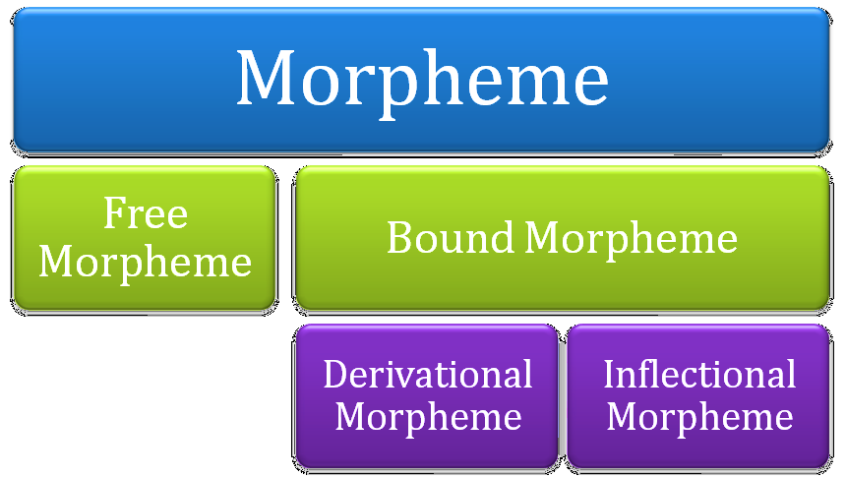
Word Tokenization in Chinese
14
 Also called Word Segmentation
 Chinese words are composed of characters
○ Characters are generally 1 syllable and 1 morpheme.
○ Average word is 2.4 characters long.
 Standard baseline segmentation algorithm:
○ Maximum Matching (also called Greedy)

Slide 15
Maximum Matching Word Segmentation Algorithm
15
 Given a wordlist of Chinese, and a string.
1) Start a pointer at the beginning of the string
2) Find the longest word in dictionary that matches the string starting at pointer
3) Move the pointer over the word in string
4) Go to 2

Slide 16
Max-match segmentation illustration
16
 Thecatinthehat
the cat in the hat
the table down there theta bled own there
 Thetabledownthere
 Doesn’t generally work in English!
 But works astonishingly well in Chinese
○ 莎拉波娃现在居住在美国东南部的佛罗里达。
○ 莎拉波娃 现在 居住 在 美国 东南部 的 佛罗里达
 Modern probabilistic segmentation algorithms even better

Slide 17
Stopping
17
 Function words (determiners, prepositions) have little meaning on their own
 High occurrence frequencies
 Treated as stopwords (i.e. removed)
○ reduce index space, improve response time, improve effectiveness
 Can be important in combinations
○ e.g., “to be or not to be”

Slide 18
Stopping
18
 Stopword list can be created from high-frequency words or based on a standard list
 Lists are customized for applications, domains, and even parts of documents
○ e.g., “click” is a good stopword for anchor text
 Best policy is to index all words in documents, make decisions about which words to use at query time

Slide 19
Case folding
19
 Applications like IR: reduce all letters to lower case
○ Since users tend to use lower case
○ Possible exception: upper case in mid-sentence?
 e.g., General Motors
 Fed vs. fed
 SAIL vs. sail
 For sentiment analysis, MT, Information extraction
○ Case is helpful (US versus us is important)

Slide 20
Morphology
20
 Morphemes:
○ The small meaningful units that make up words
○ Stems: The core meaning-bearing units
○ Affixes: Bits and pieces that adhere to stems
Often with grammatical functions

Slide 21
Stemming
21
 Stemming is crude chopping of affixes
○ Language dependant
○ E.g., automate(s), automatic, automation all reduce to automat

Slide 22
Stemming
22
 Many morphological variations of words
○ inflectional (plurals, tenses)
○ derivational (making verbs nouns etc.)
 In most cases, these have the same or very similar meanings
 Stemmers attempt to reduce morphological variations of words to a common stem
○ usually involves removing suffixes

Slide 23
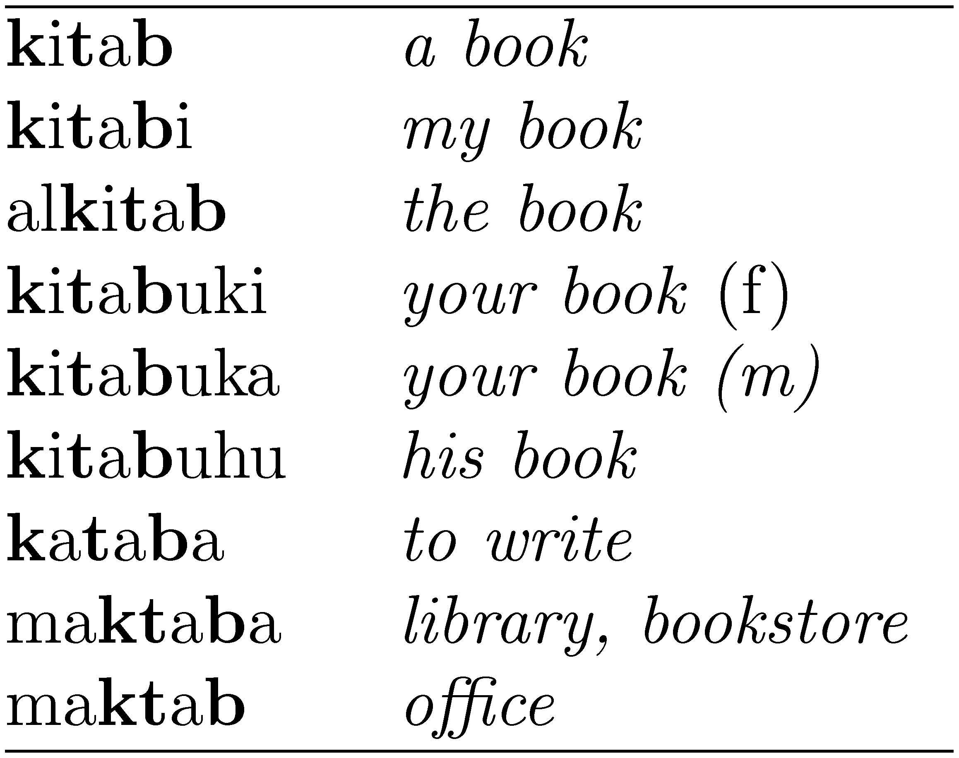
Stemming
23
 Generally a small but significant effectiveness improvement
○ can be crucial for some languages
○ e.g., 5-10% improvement for English, up to 50% in Arabic
Words with the Arabic root ktb

Slide 24
Porter Stemmer
24
 Algorithmic stemmer used in IR experiments since the 70s
 Consists of a series of rules designed to the longest possible suffix at each step
 Produces stems not words
 Makes a number of errors and difficult to modify

Slide 25
Porter’s algorithm
The most common English stemmer
25
Step 1a
sses | → | ss | caresses | → | caress
ies | → | i | ponies | → | poni
ss s | → → | ss ø | caress cats | → → | caress cat
Step 1b
(*v*)ing → | ø | walking | → | walk
(*v*)ed → | ø | sing → plastered → |  | sing plaster

Slide 26
Porter’s algorithm
The most common English stemmer
26
Step 2 (for long stems)
ational→ ate relational→ relate izer→ ize digitizer → digitize ator→ ate operator → operate
Step 3 (for longer stems)
al | → | ø | revival | → | reviv
able ate | → → | ø ø | adjustable activate | → → | adjust activ

Slide 27
Viewing morphology in a corpus
Why only strip –ing if there is a vowel?
27
 Given the description you saw on earlier slides, the Porter stemmer would stem the word 'aching' as
A. aching
B. ach
C. ache
D. aches

Slide 28
Viewing morphology in a corpus
Why only strip –ing if there is a vowel?
28
 Given the description you saw on earlier slides, the Porter stemmer would stem the word 'aching' as
A. aching
B. ach
C. ache
D. aches
Answer: B

Slide 29
Slide Credits
29
 Lecture Notes, Text Retrieval and Mining by Christopher Manning and Prabhakar Raghavan, Stanford University
 James Allan - University of Massachusetts, Amherst
 Javed Aslam – Northeastern University

